Slide 1
HEALTH INFORMATION SYSTEM
Assessment

Slide 2
Problem statement
The Health Information System is designed to manage clients, health programs, and enrollments efficiently. It provides functionality for doctors and administrators to:
Manage health programs.
Register and manage client profiles.
Enroll clients in health programs and track their enrollment status.
Provide secure API access for external systems.

Slide 3
System Design
a. Architecture
Back-end: Flask (Python) is used to handle routing, business logic, and database interactions.
Front-end: HTML, CSS are used for the user interface.
Database: SQLite is used to store data for users, clients, programs, and enrollments.

Slide 4
Database Design
The database schema is defined in schema.SQL:
Users Table: Stores admin credentials and API keys.
Clients Table: Stores client information.
Programs Table: Stores health program details.
Enrollments Table: Tracks client enrollments in programs.

Slide 5
Key Components
Authentication:
Login system for administrators using session-based authentication.
API access secured with API keys.
Client Management:
Add, view, and search for clients.
Store personal information such as name, ID, date of birth, gender, contact, and address.
Program Management:

Slide 6
Key Components
Create, view, and edit health programs.
Programs include details like name and description.
Enrollment Management:
Enroll clients in health programs.
Track enrollment status (Active, Inactive, Completed).
Dashboard:
Display statistics for total clients, programs, and enrollments.
Provide quick actions for common tasks.
API:
Expose client profiles and enrollments via secure API endpoints.

Slide 7
Solution
The system provides a comprehensive solution for managing health programs and client enrollments:
Ease of Use: Intuitive UI for managing clients and programs.
Scalability: Modular design allows for future enhancements (e.g., adding more API endpoints).
Security: Secure authentication and API access.
Data Integrity: Relational database ensures consistency across clients, programs, and enrollments.

Slide 8
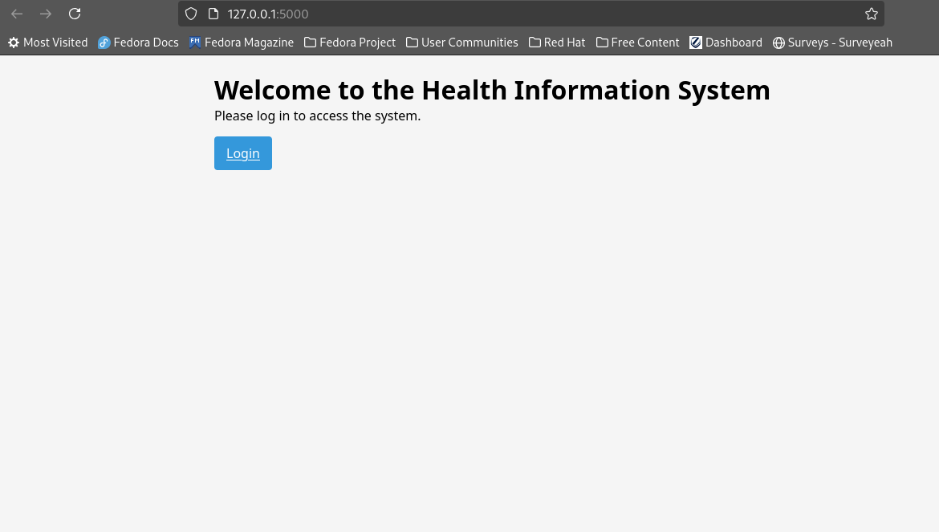
Welcome interface

Slide 9
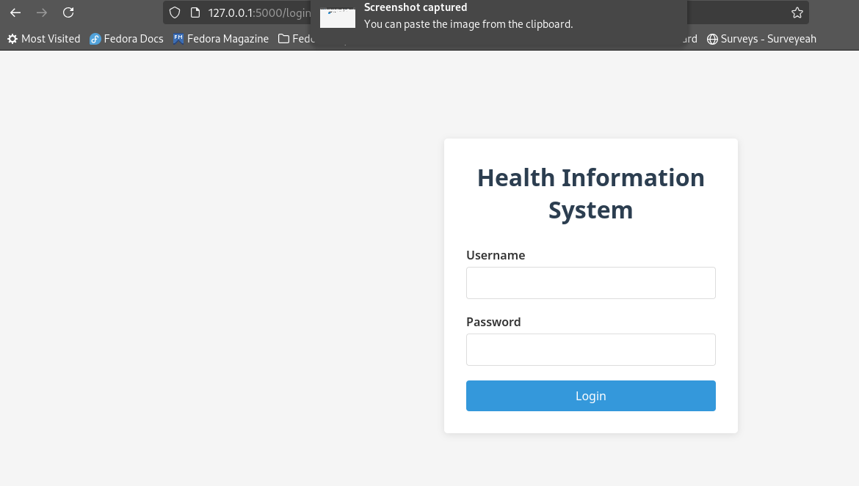
Login interface

Slide 10
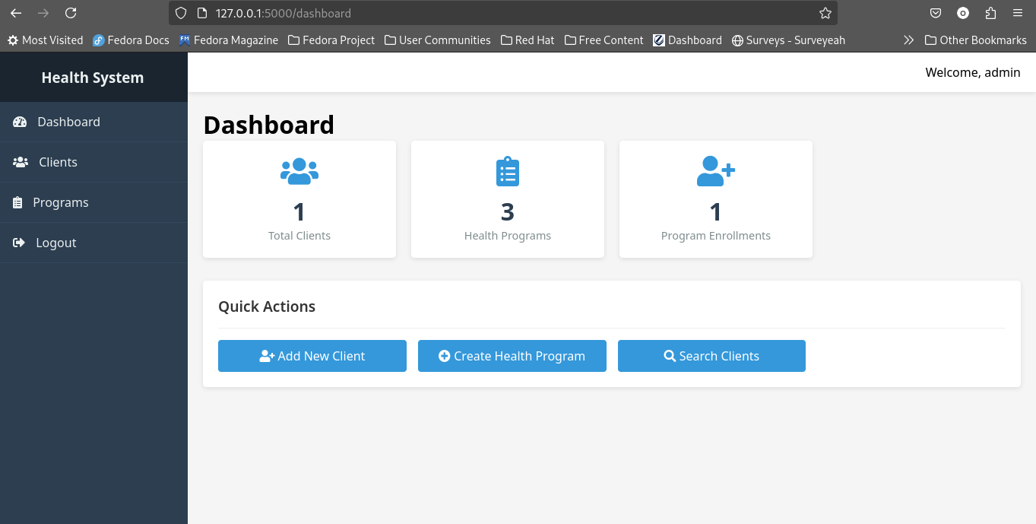
Dashboard

Slide 11
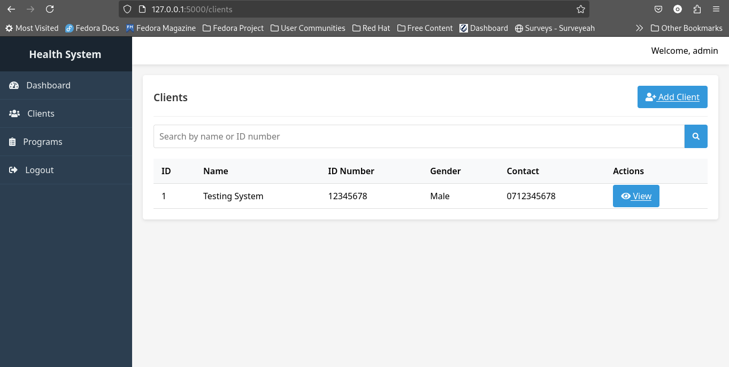
Manage client

Slide 12
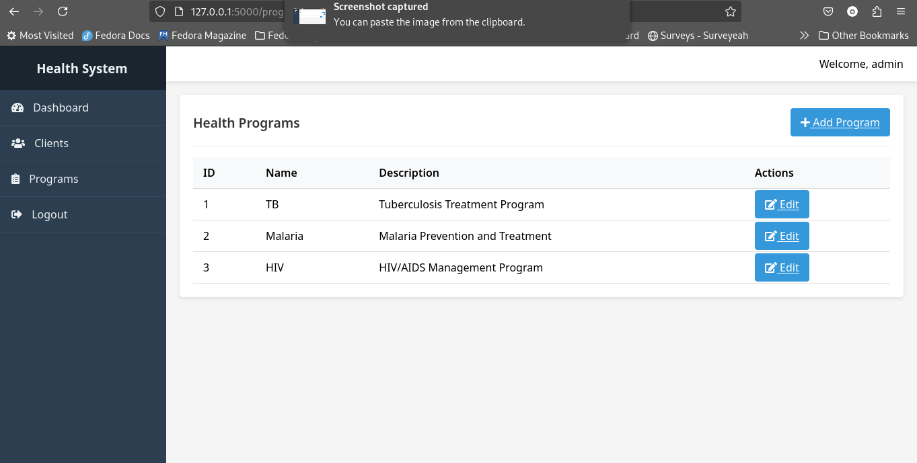
Manage Programs

Slide 13
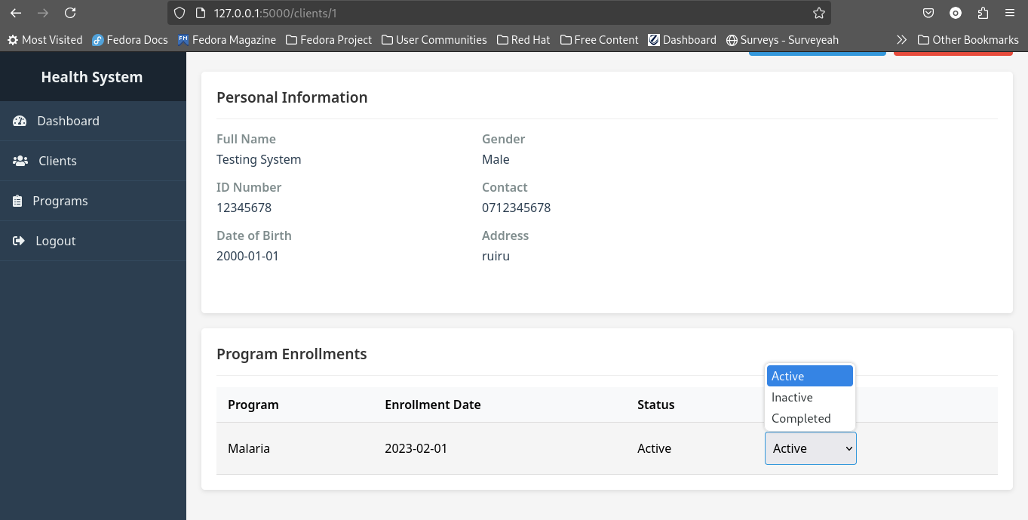
Add personal infomation

Slide 14
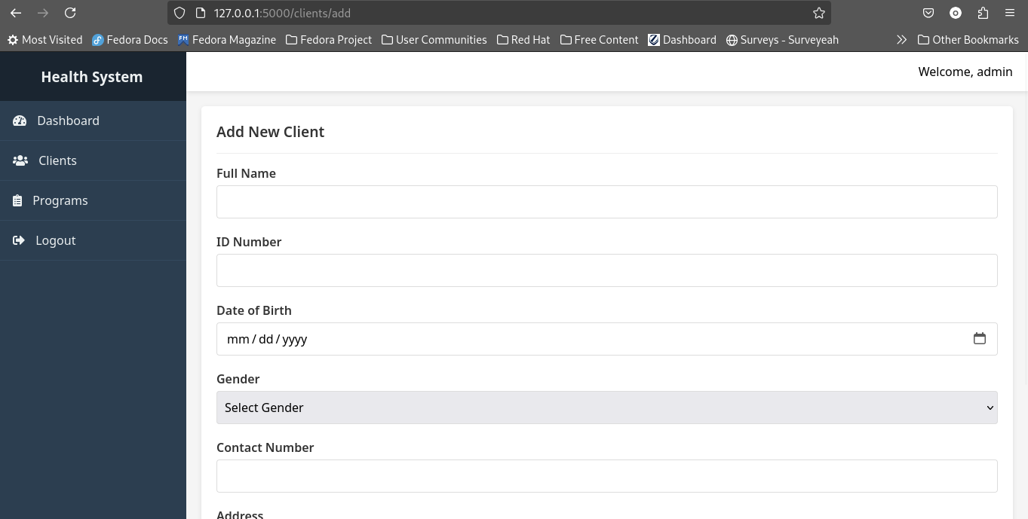
Add new client

Slide 15
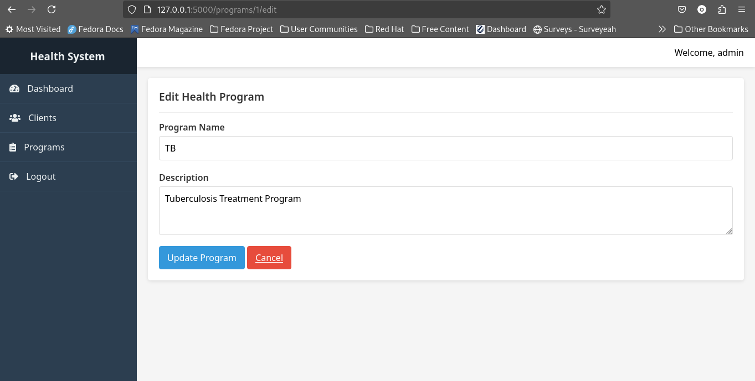
Edit health program

